Slide 1
Additional Features of Procedures

Slide 2
Passing n-Rank Arrays to Procedures
Multidimensional arrays can be passed provided the procedure knows:
Number of dimensions
Extent of each dimension
Three ways to pass this information:
Explicit-Shape Dummy Arrays
Assumed-Shape Dummy Arrays
Assumed-Size Dummy Arrays

Slide 3
Explicit-Shape Dummy Arrays
Array and extent of each dimension is passed.
Extent values used to declare the size of the array.
When using explicit-shape dummy arrays:
Size and shape of each array known to the compiler.
Array operations and sections are possible.

Slide 4
Assumed-Shape Dummy Arrays
Declared using a colon as a place holder for each subscript
Procedure must have an explicit interface.
Whole array operations, array sections, and array intrinsic functions can be used.
Upper and lower bounds of each dimension can not be determined. (Only the shape not the bounds are is passed)

Slide 5
Explicit Interface
Calling program knows everything about the subroutine interface
Accomplished by placing the procedure into a module.

Slide 6
Assumed-Size Dummy Arrays
Arrays in which the lengths of all but the last dimension are declared explicitly.
The length of the last array dimension is specified with an asterisk (*).
Holdover from older versions of FORTRAN
Should not be used in any new program.

Slide 7
The SAVE Attribute
According to the FORTRAN standards:
Values of all local variables and arrays in a procedure become undefined whenever execution exits the procedure.
The SAVE attribute is way to save local variables and arrays between calls.
Any local variables declared with the SAVE attribute will be saved between calls to the procedure.
REAL, SAVE :: Sums

Slide 8
SAVE Attribute Note
Any local variable initialized in the type declaration is automatically saved.
So:
REAL, SAVE :: Sums = 0
Is equivalent to:
REAL :: Sums = 0

Slide 9

The SAVE Statement
Non-Executable statement
Placed in declaration section of Procedure
Any local variable listed will be saved unchanged between calls
If no variable is listed then all local variable will be saved:

Slide 10
Allocatable Arrays In Procedures
Must be declared as a local variable
If declared with the SAVE attribute
Array allocated once the first time the procedure is called.
Contents preserved between calls.
Allocated without the SAVE attribute
Must be allocated every time procedure called
Automatically deallocated when execution returns to calling program.

Slide 11
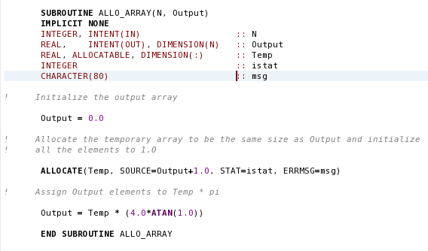
Allocatable Array Example:

Slide 12
Automatic Arrays
Temporary Arrays, explicitly-shaped with non-constant bounds
Local to the procedure.
Destroyed when execution returns.
Can not be initialized in the type declaration.
Can not be saved between calls.
May be passed as a calling argument to procedures invoked by the procedure which created it.

Slide 13
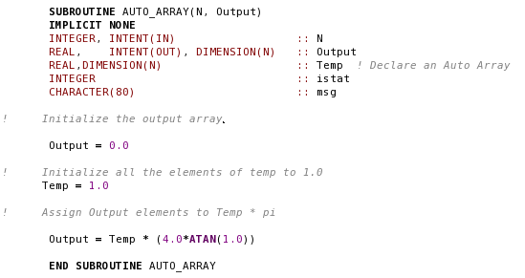
Automatic Array Example:

Slide 14
Comparing Automatic and Allocatable Arrays
Allocation:
Automatic arrays automatically created at the beginning of the procedure.
Allocated arrays must be allocated and deallocated manually.
Allocatable arrays are more general and flexible.
Allocatable arrays can be resized during a calculation.

Slide 15
FORTRAN Arrays
Explicit-Shape Arrays with Constant Bounds
Shape declared in type declaration statement
Fixed, permanent arrays
Automatic Arrays
Temporary, explicitly shape arrays with non-constant bounds
Created locally in a procedure
Destroyed at the end of the procedure
Deferred-Shape Arrays
Allocatable arrays
Dimensions declared with a colons

Slide 16
FORTRAN Dummy Arrays
Explicit-Shape Dummy Arrays
Dimensions explicitly declared by arguments
Assumed-Shape Dummy Arrays
Dimensions declared with colons
Usable only with an explicit interface
Assumed-Size Dummy Arrays
OBSOLETE – SHOULD NOT BE USED

Slide 17
New FORTRAN 2003 Procedures
Allocatable dummy arguments are now possible.
Function can now return an allocatable value.

Slide 18
Allocatable Dummy Arguments
Must have an explicit interface
Allocatable dummy arguments are allowed to have INTENT attribute
INTENT(IN) –
Can not be allocated or deallocated in subroutine
Values in array cannot be modified
INTENT(INOUT) –
The status (allocated or not) and data will be passed in.
May be deallocated, reallocated or modified in subroutine
Final status and data will be passed back.
INTENT(OUT) –
Actual argument in Calling program automatically deallocated on entry
Subroutine may used the unallocated argument in any way
Final status and data will be passed back.

Slide 19
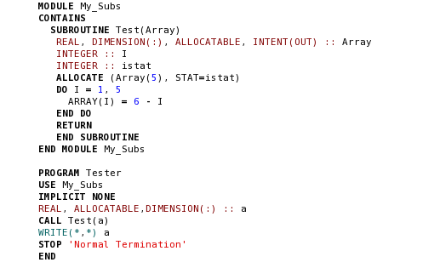
Allocatable Dummy Argument Example:

Slide 20
Allocatable Functions
A function result is permitted to have an ALLOCATABLE attribute
The variable may be allocated, deallocated, and reallocated as many time as desired.
Must be allocated and contain a value before the function returns.

Slide 21
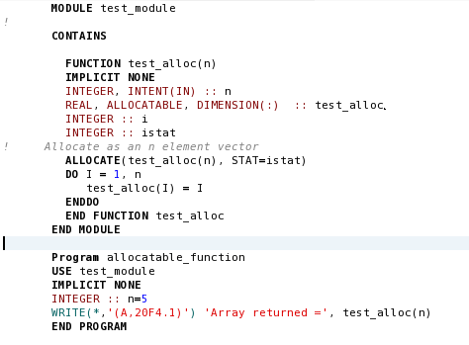
Allocatable Function Example:

Slide 22
PURE and ELEMENTAL Procedures
FORTRAN has been evolving in ways to make it easier to execute on massively parallel processors.
FORTRAN 95 introduced two new classifications of procedures:
PURE procedures
ELEMENTAL procedures

Slide 23
PURE Procedures: PURE Function
A function that has no side effects:
Does not modify their input arguments.
Does not modify any other data. (i.e. shared data in a module)
Local variables:
May not have the SAVE attribute.
May not be initialized in the type declaration statement.
Every argument must be declared with INTENT(IN).
Any procedure(s) invoked by a PURE function must also be PURE.
Must not perform any external I/O operations.
Must not contain a STOP statement.
Declared by adding a PURE prefix to the function statement.

Slide 24

PURE Function Example:
Because it has no side effects, PURE functions are safe to
invoke in a FORALL Construct where they may be executed in any order.

Slide 25
PURE Procedures: PURE Subroutines
Subroutines without side effects.
Constraints the same as PURE functions except:
Permitted to modify arguments declared INTENT(INOUT) and INTENT(OUT)
Declared by adding the PURE prefix to the SUBROUTINE statement.

Slide 26
ELEMENTAL Procedures
Elemental functions – functions specified for scalar arguments, but may also be applied to array arguments.
Elemental functions
Must be PURE functions
All dummy arguments must be scalars
The function result must be a scalar.
Dummy arguments must not be used in type declaration statements (this constraint prohibits automatic arrays.)
Declared by adding an ELEMENTAL prefix to the function statement.

Slide 27
ELEMENTAL SUBROUTINES
Subroutines specified with scalar arguments but may also apply to array arguments.
Must meet the same constraints as ELEMENTAL functions.
Declared by adding an ELEMENTAL prefix to the SUBROUTINE statement.

Slide 28
Internal Procedures
There are three types of procedures:
External procedures
Module procedures
Internal procedures
Internal procedures is a procedure contained entirely within another program unit (or host).
Compiled together with the host.
Can only be invoked by the host.
Introduced using the CONTAINS statement
Must follow all the executable statements of the host

Slide 29
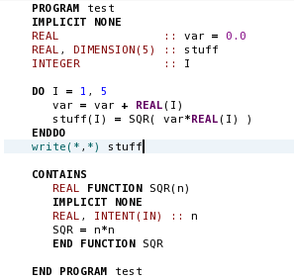
Internal Procedure Example:

Slide 30
Functions of an Internal Procedure
An internal procedure function just like an external procedure with the following exceptions:
It can only be invoked from the host
Name of the internal procedure may not be passed as an argument to another procedure
It inherits all data entities of the host by host association.
The only time the procedure cannot access a data entity defined in the host is when the procedure defines a different data entity using the same name.
In this case, the data entity in the host will be totally unaffected.

Slide 31
Good Coding Practice
Always use either explicit-shape or assumed-shape dummy array arguments.
If the procedure requires that a value of a local array not change between successive invocations, use either the SAVE attribute or the SAVE statement
Use automatic arrays to create temporary arrays in procedures.
Use allocatable arrays
In the main program.
When arrays will be created and destroyed in different procedures.
When arrays must change size in a procedure.
Use internal procedures to perform low-level manipulations repeatedly but are needed only by one program unit.

